Slide 1
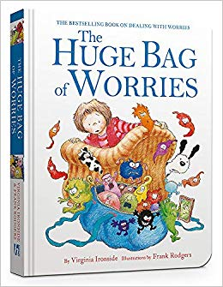
The Worry Matrix
Worrying is mental clutter
Worrying is like praying for something your don’t want
The key is less worrying and more action
The Worry Matrix will help you decide what’s worth worrying about, and what isn’t
How likely is something to happen, Is it inside or outside of your control
Can this help inform assessment of risk?

Slide 2
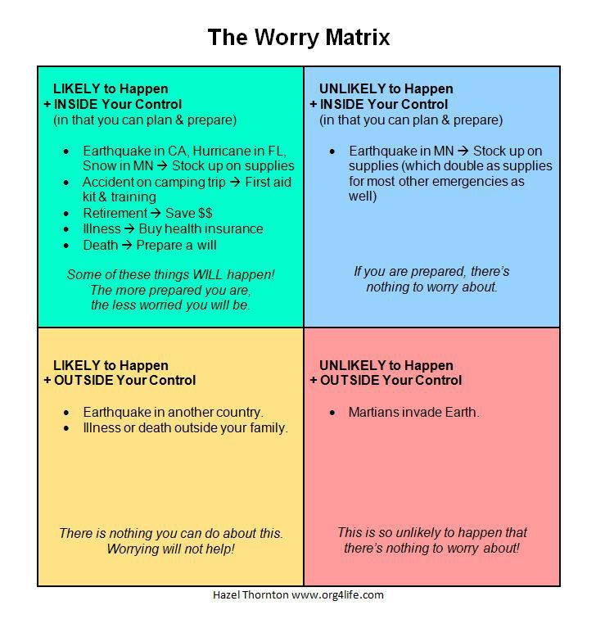
The Worry Matrix

