Slide 1
The Five Whys
Why?
Why?
Why?
Why?
Why?
Notes:
Familiar with the 5 whys to get to the route to the problem:
Why are single use plastics an issue?
Because they don’t biograde and cause issues for landfill and marine life
Why?
Because they are disposable and don’t break down quickly?
Why?
Because there is demand for cheaply mass produced straws by pubs, cinemas, restaurants, school etc
Why
Businesses haven’t been aware of the environmental impact of what they are producing
Why
Consumerist approach to production
Why
No recognised need for any alternative
Why are people late for work?
Traffic
Why
Volume of road users
Why
More people drive than take the train, not reliable
Why
Not enough investment in public transport

Slide 2
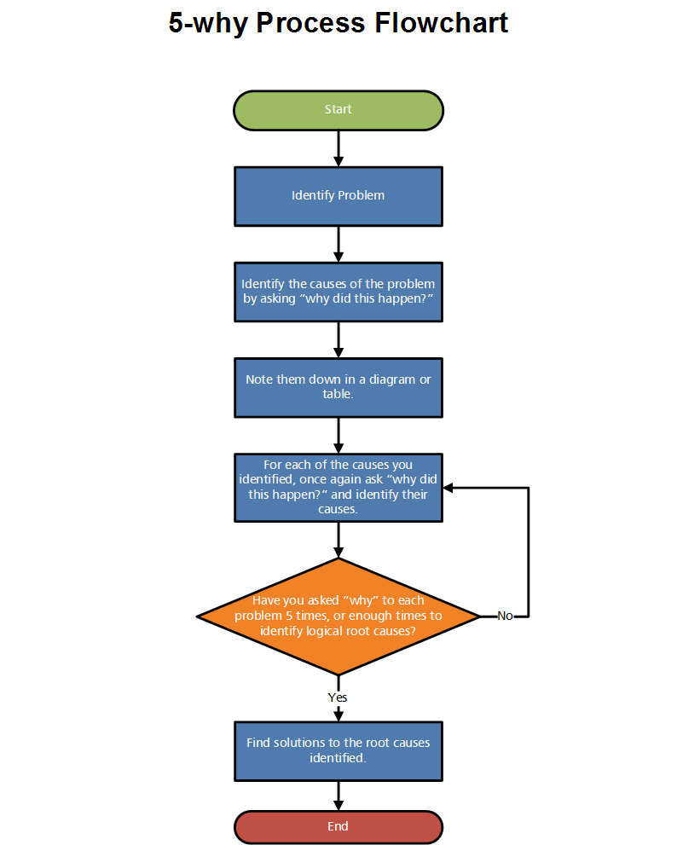
The 5 Whys
Use the 5 Whys to understand the root of any problem
Developed by Toyota as part of problem-solving training
How to run a “5 Whys”
Gather those affected by the issue
Select a leader for the discussion
Ask “why” five times – key is getting the right question to start
Assign responsibility for solutions
Circulate and share the results

