Slide 1
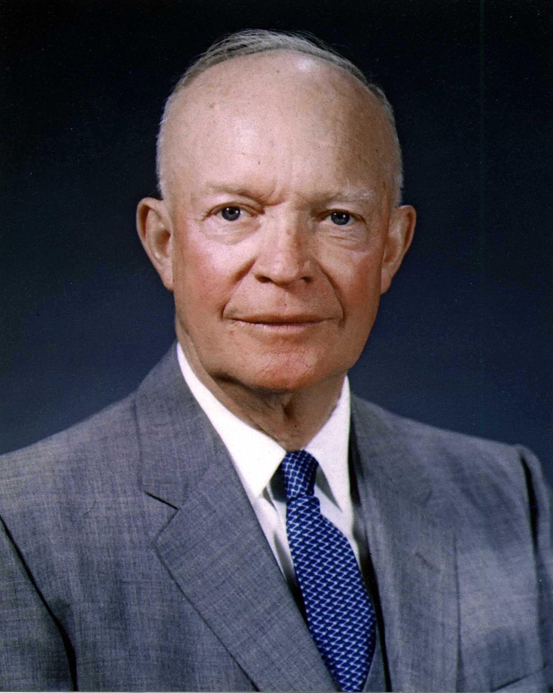
The Eisenhower Box
US President Eisenhower productivity strategy
Can be used for broad planning to daily planning – “What should I do today?”
“What is important is seldom urgent and what is urgent is seldom important” Eisenhower
Urgent tasks are things you feel you need to react to
Important tasks are tasks which contribute to your goals
Ask yourself “Do I actually need to be doing this?”
Can you eliminate tasks you are comfortable doing but isn’t the best use of your time
It is crucial that you know what you are working towards

Slide 2
The Eisenhower Box
URGENT
NOT URGENT
Do
Plan
Delegate
Eliminate
IMPORTANT
NOT
IMPORTANT
Urgent and Important (tasks you will do immediately)
Important, but not urgent (tasks you will schedule to do later)
Urgent, but not important (tasks you will delegate to someone else)
Neither urgent nor important (tasks you will eliminate)
Notes:
What needs to happen next?

