Slide 1


The Future of Professional Procurement Development
Outcomes from the Annual Conference Exercises
Ian McNaught
Strategic Organisational Development Manager
27 September 2022

Slide 2
The Future of Professional Procurement Development
Outcomes from the Force Field Analysis Exercises
Background
During the annual conference nine groups explored their needs for the future of professional procurement development. The data has been analysed, collated and is shared on slide#3.
Methodology
The data source is anonymous. An arbitrary group number is allocated for analysis purposes.
Each group’s force field analysis is analysed using the dotmocracy scoring.
The three highest dotmocracy scores are captured representing the prioritised needs of each group.
Then the three highest scores are grouped together representing the needs of all nine groups.

Slide 3
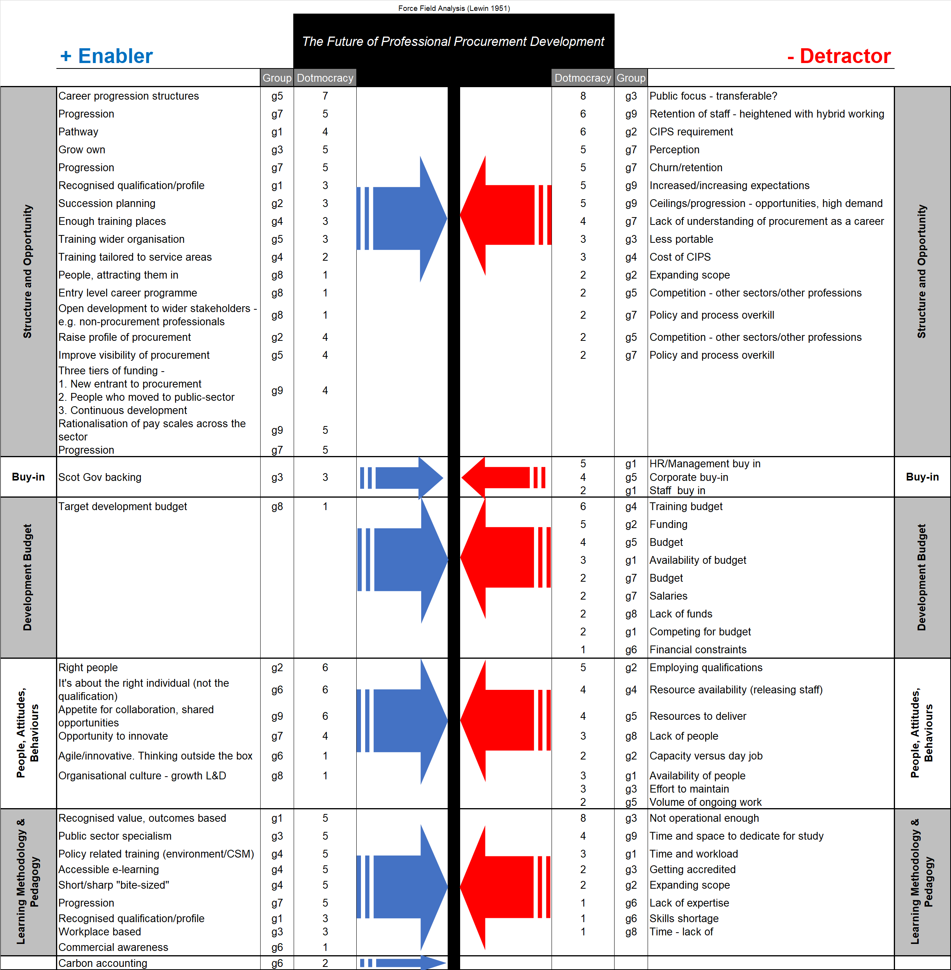
The full data set and analysis can be viewed in this Excel spreadsheet.

Slide 4
Proposed Outcomes from Professional Procurement Development Exercises
Five grouped outcomes are created from the force field analysis exercises. These are -
Structure and Opportunity. Slides 5 and 6.
Buy-in. Slide 7.
Development Budget. Slide 8.
People, Attitudes, Behaviours [Culture]. Slide 9.
Learning Methodology and Pedagogy. Slide 10.
Slides 5 to 10 summarise each outcome in turn proposing a fit for purpose progressive way forward.
Slides 11 & 12 provide a summary of the development portfolio, illustrating the active strategy and the emergent strategy.
These outcomes propose prices and development durations on average ~50% less than the active strategy. Implementing these outcomes will meet our community’s requests to the Academy.

Slide 5
1. Structure and Opportunity
The Future of Professional Procurement Development
1. Structure and Opportunity
The emerging strategy provides significantly lower price points and shorter development duration.
Unaccredited structured pathway for our national development needs.
Unaccredited 1-hour Stay Connected workshops.
Unaccredited Scot Gov procurement and commercial training framework one-day development workshops.
Unaccredited half-day Evolve workshops.
Unaccredited one-day Evolve workshops.
Accredited structured pathway for our national development needs.
Accredited programmes of 4 months to 12 months duration, across multiple disciplines.
Procurement Practitioner accredited by SQA.
Procurement Expert Practitioner accredited by SQA.
Procurement Master Practitioner accredited by SQA.
Operational leadership and management accredited by SQA.
Strategic leadership and management accredited by SQA.
Strategic leadership accredited by SQA.
Project management accredited by SQA.
Managing projects and business processes accredited by SQA.
Business analysis, decision making and innovation accredited by SQA.
Coaching and mentoring accredited by SQA.
Graduate apprenticeships – this development opportunity will be considered outwith this scope.
This structure provides a development pathway, within a discipline and spanning multiple disciplines.
Multiple developmental levels, from early career to expert – underpinned with the development framework.
An opportunity to support peoples’ development needs across their whole career, at the right time.
An opportunity to coact with our local authorities, Scot Gov directorate, PPD forum and the Academy.
Create a national development provision and raise the profile of procurement, as a discipline and career.

Slide 6


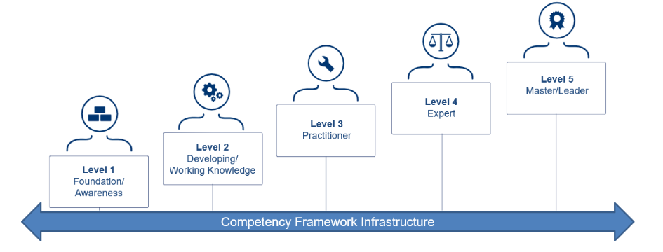
I
Academy Emergent Strategy Alignment with
National Procurement Development Framework
Short-Duration
Development
Public-Sector Practitioner SCQF8
Public-Sector
Expert Practitioner SCQF9
Public-Sector
Master Practitioner SCQF11
Non-Accredited
SQA Accredited
SQA Accredited
SQA Accredited
Scottish Government
Procurement and Commercial Training Framework (PCTF)
Half-day & One-Day
Graduate Apprenticeship Procurement & Supply Chain Management
SCQF10
Graduate Apprenticeship Business
Management
SCQF10
Stay Connected
One Hour Online
Topics out of scope in PCTF
(Scottish Government PPD 2022)
Evolve
Half-Day & One-Day
Topics out of scope in PCTF
Operational Leadership & Management SCQF8
Strategic Leadership & Management SCQF9
Strategic Leadership SCQF11
SQA Accredited
SQA Accredited
SQA Accredited

Slide 7
The Future of Professional Procurement Development
2. Buy-in
The Academy is committed to supporting your needs, with a lower-cost shorter development time approach.
The Scottish Government directorate is committed to collaborate and cobrand our national development.
With your buy–in…
We can have collective scale as we progress, with resultant economies of scale advantages.
We can influence regionally and nationally, creating the right way forward.
We can coact, cocreate, codeliver and collaborate to create the most fit for purpose development provision.
Collectively, we can strive to influence HR, L&D, OD, Chief Execs (CEOMG).
Empowering our people to tackle the operational and strategic barriers/opportunities creates buy-in.

Slide 8
The Future of Professional Procurement Development
3. Development Budget
With a coaction approach we can facilitate economies of scale advantages.
We can influence as a collective across HR, L&D, OD, Chief Execs (CEOMG) tackling wicked problems…
Fit for purpose lower cost shorter duration development programmes are an enabler.
Lower cost shorter duration development programmes will maximise the impact of our budgets.
Can we acquire a regional/national development budget???
Graduate Apprenticeships (GA) offer additional budgetary advantages.
The GA development opportunity will be considered outwith this scope.
Our development provision can be structured to offer recognised learning as a pathway to GAs.
This will reduce operational costs.
This will reduce a person’s commitment to the number of hours of learning.

Slide 9
The Future of Professional Procurement Development
4. People, Attitudes, Behaviours [Culture]
We can develop autonomous socially responsible thinkers to tackle our wicked problems of today and tomorrow.
With a focus on peoples’ attitudes and behaviours as these create our organisational culture.
This extends to the individuals’ appetite for collaboration and innovation.
Develop and facilitate “our” organisational culture, starting with a series of Evolve workshops.
Develop and facilitate ability-motivation-opportunity across our people and organisations.
Facilitate intrinsic-extrinsic motivation with transformational leadership.
Develop autonomy-competence-relatedness, aligned to our vision-mission-strategy-operating plan.
Empower innovative work behaviours with explorers-exploiters deploying acquire-assimilate-transform.
Trust-based leaders facilitate the cognitive-emotional disorienting dilemma.
Establish the right leadership to enable and empower peoples’ attitudes and behaviours.
Underpin all of this with transformational leadership.

Slide 10
The Future of Professional Procurement Development
5. Learning Methodology & Pedagogy
Applied work-based-learning workshops and programmes – facilitating operational delivery and strategic thinking.
Time concise useful learning, acquiring skills today and applying them tomorrow for a quick return.
Supportive and safe environment, whilst constructively challenging.
Depth of knowledge within a discipline and breadth across disciplines – supporting career pathways.
Facilitate transformative learning whilst managing the cognitive-emotional disorienting dilemma.
Facilitate autonomous thinkers’ critical reflection and critical discourse with peers, partners and decision-makers.
Structured people development comprising -
Online workshops.
Face-face workshops.
Discussion forums.
Break out room discussions.
Video content.
E-learning.
Practical exercises.
Time for reflection.
Using a blended approach of flipped classroom, jigsaw learning, critical reflection and critical discourse.
All workshop/programme content are downloadable from the Academy Moodle platform in a secure environment.
Unaccredited option.
Accredited option, with a summative assessment applied project and/or professional discussion.
Useful acquired skills are applied directly to the learner’s work environment, improving their work practice.
Tutor support is easily accessible via Moodle messaging, MS Teams video calls and email.

Slide 11
The Academy Work-Based-Learning Portfolio
Procurement
Leadership & Management
Project Management
Business Analysis and Innovation
Practitioner
(RQF4/SCQF7)
PS Practitioner
(SCQF8)
Leadership & Mgt Certificate (RQF5)
PDA Operational Leadership & Mgt
SQA (SCQF8)
PDA Project Management (SCQF8)
Business Analysis Unit (SCQF8)
Advanced Practitioner
(RQF5/6 SCQF8/9)
PS Expert Practitioner (SCQF9)
Leadership & Mgt Certificate (RQF6)
PDA Strategic Leadership & Mgt
SQA (SCQF9)
PDA Managing Projects & Business Processes (SCQF9)
PDA Decision Making & Innovation (SCQF9)
PS Master Practitioner (SCQF11)
Leadership & Mgt Diploma (RQF5)
PDA Strategic Leadership
SQA (SCQF11)
More info here
More info here
Depth within discipline
Strategic Leadership Diploma (RQF7)
CIPS
SQA
PDA Coaching & Mentoring
SQA (SCQF8)
More info here
Coaching & Mentoring
Diploma (RQF5)
Stay Connected
One-Hour Online
Evolve
Half-Day & One-Day
Chartered Manager (CMgr)
More info here
To be launched…
More info here
Breadth across multiple disciplines – facilitating career pathway and personal development needs

Slide 12
The Art of the Possible: Lower Price Point & Shorter Development Duration
Focusing on our community’s request for lower priced shorter development duration programmes, this slide compares the active strategy with the proposed emergent strategy.
Items in black are sustained across both strategies.
Items in blue are new workshops/programmes that will be developed and delivered by the Academy.
Items in grey will be implemented in a future iteration of the strategy, conditional upon our community’s confirmed needs.
Academy Active Strategy
Academy Emergent Strategy
The emerging strategy will be 100% aligned to our national procurement development framework - refer to slide#6.

Slide 13


Supporting People Development and Organisational Development
Ian McNaught
Strategic Organisational Development Manager
M: 07805 035565
E: ian.mcnaught@scotland-excel.org.uk
E: academy@scotland-excel.org.uk
Academy Moodle https://academy.scotland-excel.org.uk
@TheAcademySXL

