Slide 1
Placemat
Very useful approach to generating ideas for a particular issue, topic or question quickly
How to carry out a Placemat Activity
  Divide into groups (groups of 4 are ideal)
  Provide each group with one placemat sheet with the sheet divided so that there is an outside section for each group member and a central box for gathering collective responses
  Set time for the group to consider the issue/topic/question and during this time each group member will work individually inputting ideas into their space on the sheet
  Each member of the group will share their responses to the rest of the group
  The group will then collectively decide on the most important/significant responses and record them in the middle of the placemat – these could even be ranked

Slide 2
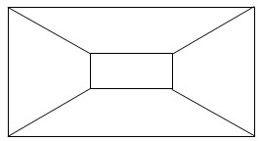
Placemat
Catherine’s Space
Jenni’s Space
Collective Space for agreed most important/significant responses
Rachel’s Space
Melanie’s Space

